Slide 1
Year 6
Information Evening for Parents
2016-17

Slide 2
Our Staff:
Mr Weston
Mrs Buckroyd (Wednesday – Thursday)
Mrs Parker
Mr Maiden
Mrs Ashington

Slide 3
Groupings
Monday, Tuesday & Friday:
Whole class with Mr Weston, Mrs Parker & Mr Maiden
Wednesdays &Thursdays:
Literacy & Numeracy ‘smaller’ classes split between Mrs Buckroyd & Mr Weston

Slide 4
Rewards
Star of the day/week
Class points
Raffle tickets (new system)

Slide 5
Homework
Projects & Presentations will be set regularly & at various points throughout the year.
Volume will increase after Christmas to begin preparations for high school

Slide 6
SPELLING
Weekly Spellings – please help to practise these at home / walking to school / in car etc.
Amounts of words & difficulty of words will vary based upon a baseline assessment & will be reviewed regularly throughout the year.

Slide 7
Reading
Reading for PLEASURE (eg. E.R.I.C)
Please still have DISCUSSIONS about their reading even if not ‘listening to them as such’

Slide 8
Number Zumba
Mental maths ‘learn by heart’ facts that will boost your child’s Maths attainment overall
Please also continue to practise times tables facts (as with spelling little & often – 5 mins a day here & there)

Slide 9
ASSESSMENT
Y6 children will still be teacher assessed as
Emerging/Developing/Secure/Mastering for Reading, Writing (English) & Maths.
End of year SAT’s tests
(Revision period & workbooks for homework, etc)

Slide 10
Key stage 2 – SAT’s Test TIMETABLE
The key stage 2 tests are timetabled from Monday 8 May to Thursday 11 May 2017.
There is no science sampling for the 2016 to 2017 academic year.
Date | Activity
Monday 8 May 2017 | English reading
Tuesday 9 May 2017 | English grammar, punctuation and spelling Paper 1: questions
 | English grammar, punctuation and spelling Paper 2: spelling
Wednesday 10 May 2017 | Mathematics Paper 1: arithmetic
 | Mathematics Paper 2: reasoning
Thursday 11 May 2017 | Mathematics Paper 3: reasoning

Slide 11
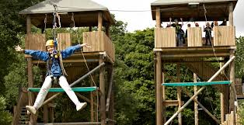
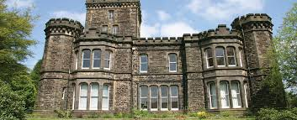
Trips
Regular day trips
I.M.P.S visit to Airedale hospital
Shared Church (Keighley),
Culture Fusion (Metro bus/train info.) etc
Robin Wood RESIDENTIAL visit
(3 days in June/July 2016)

Slide 12
Thanks for your continued support

